Slide 1



4th Grade Parent Informational
MSCS Literacy Commitment
February
Crump Elementary School
LEARN. LEAD. LEAVE A LEGACY.
Notes:
Greetings,
Welcome to the 4th Grade Parent Informational Commitment Meeting!

Slide 2

Agenda
What is Adequate Growth?
Impacted 4th Graders
4th Grade Promotional Requirements
4th Graders not Impacted
Parent Notification
LEARN. LEAD. LEAVE A LEGACY.

Slide 3

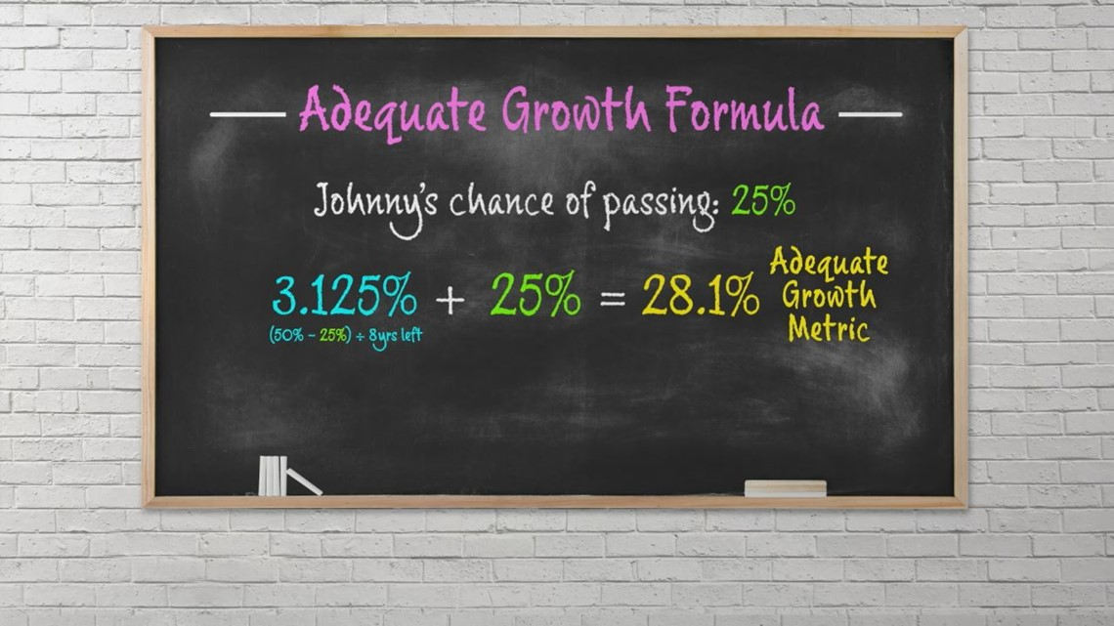

Adequate Growth
LEARN. LEAD. LEAVE A LEGACY.

Slide 4
Adequate Growth
What is Adequate Growth?
Adequate growth is defined by the Tennessee Department of Education (TDOE) using a complicated formula that indicates whether a student is on track to master the educational standards established by the state. The lower a student's third grade ELA TCAP score, the more growth is required.
When will schools be informed of 4th grade students’ adequate growth?
Students will be identified as meeting their adequate growth requirement after the 2025 TCAP has been scored (usually late May).
LEARN. LEAD. LEAVE A LEGACY.

Slide 5


How are 4th Graders impacted?
LEARN. LEAD. LEAVE A LEGACY.

Slide 6
IMPACTED 4TH GRADERS
Fourth grade students in the following scenarios must score proficient or successfully meet their adequate growth target on their fourth grade ELA TCAP to be promoted to fifth grade:
• A student whose highest performance level on the 3rd grade ELA TCAP or ELA TCAP retake assessment was “approaching” and was promoted to fourth grade on the condition of receiving tutoring for the entirety of fourth grade,
OR
• A student whose highest performance level on the 3rd grade ELA TCAP or ELA TCAP retake assessment was “below” and was promoted to fourth grade on the conditions of attending summer learning loss bridge camp with 90% attendance prior to fourth grade and receiving tutoring for the entirety of fourth grade.
LEARN. LEAD. LEAVE A LEGACY.

Slide 7
4th Grade Promotional Requirement
If a qualifying student does not score proficient or meet their adequate growth target on the fourth grade ELA TCAP, a conference with the student’s principal, ELA teacher, and parent or legal guardian must convene to determine whether the student will be:
• promoted and receive tutoring for the entirety of fifth grade,
OR
• retained in the fourth grade. A student may only be retained in fourth grade one time.
If a unanimous decision is not reached during the promotion discussion, each participant category (principal, ELA teacher, and parent/guardian) may make a single recommendation for consideration in the decision. The decision is determined by a majority of the category of participants.
LEARN. LEAD. LEAVE A LEGACY.

Slide 8
4th Grade Students not Impacted
Current fourth grade students in the following scenarios are not required to score proficient or meet an adequate growth target on their fourth grade ELA TCAP or participate in tutoring to be promoted to fifth grade:
• a student whose highest performance level on the 3rd grade ELA TCAP or ELA TCAP retake assessment was “approaching” and was promoted to fourth grade by meeting summer learning loss bridge camp attendance and adequate growth requirements,
• a student who received an approved appeal, or
• a student who was exempt from retention.
If a unanimous decision is not reached during the promotion discussion, each participant category (principal, ELA teacher, and parent/guardian) may make a single recommendation for consideration in the decision. The decision is determined by a majority of the category of participants.
LEARN. LEAD. LEAVE A LEGACY.

Slide 9


Parent Notification
LEARN. LEAD. LEAVE A LEGACY.

Slide 10
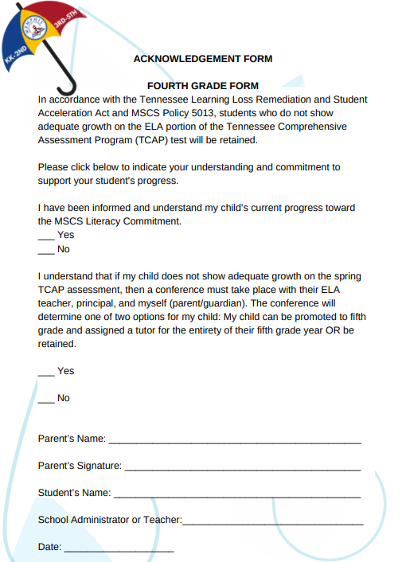
Electronic Parent Acknowledgement
The purpose of the Parent Acknowledgment- Signature Page is to:
Indicate your understanding the MSCS Literacy Commitment and your student's progress.
Acknowledge that you have been informed and understand your child’s current progress towards the MSCS Literacy Commitment.
Acknowledge that you understand that if your child does not show adequate growth on the ELA portion of the 2025 Spring TCAP Assessment, a promotional conference must take place as outlined by the Tennessee Learning Loss Remediation and Student Acceleration Act as outlined by the State Department of Education.
LEARN. LEAD. LEAVE A LEGACY.

Slide 11
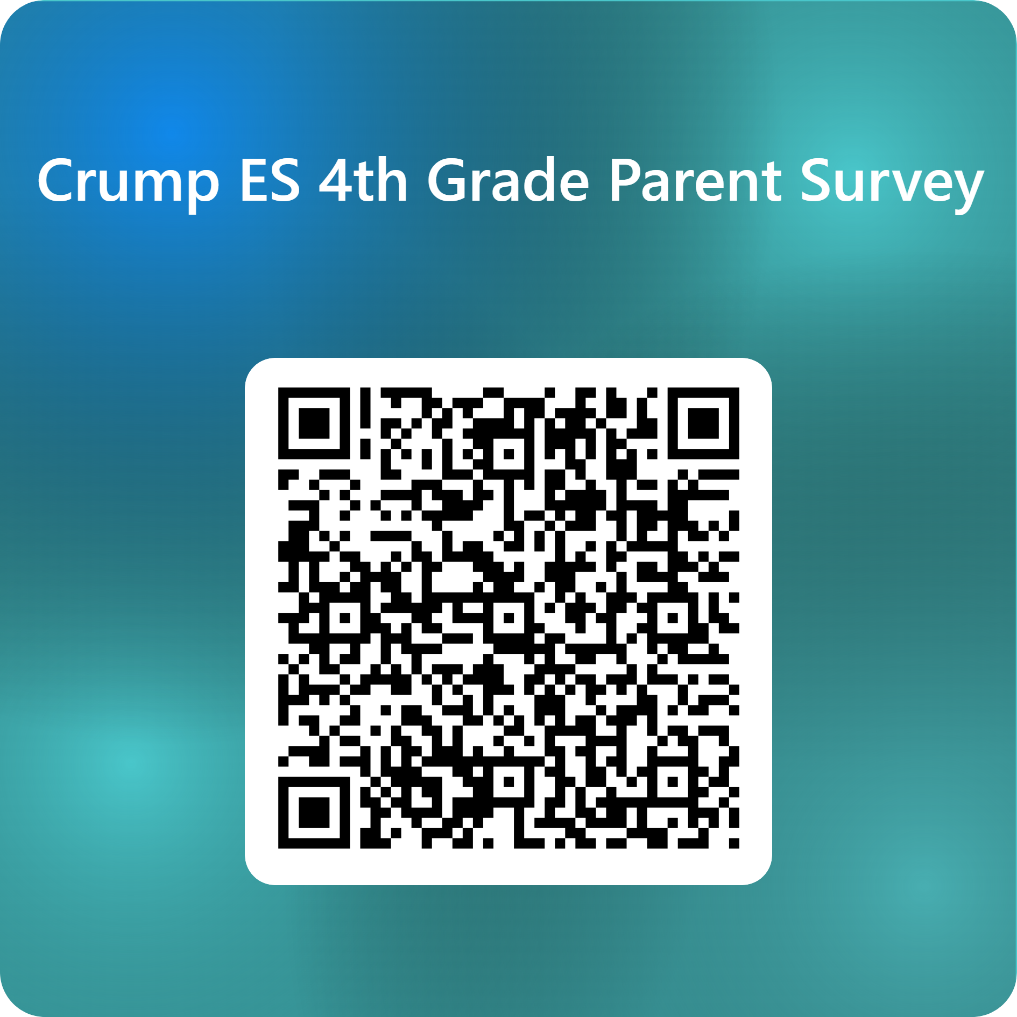
https://forms.office.com/r/1Ti37DRxLU
Complete Survey
LEARN. LEAD. LEAVE A LEGACY.

Slide 12

Add School Contact Information
LEARN. LEAD. LEAVE A LEGACY.

